Slide 2







































































Software Engineering
The Good Bits (the bits AI can’t replace)

Slide 3

Software Engineer
5+ years experience with SPA web application development
Angular, TypeScript, SASS
3+ years .NET development
RESTful API design
F# a plus
3+ years experience with PostgreSQL and database optimization
3+ years experience with NodeJS, NestJS and Redis
3+ years Azure experience with Kubernetes
Jenkins, BitBucket, JetBrains Rider, Bootstrap experience a must

Slide 4

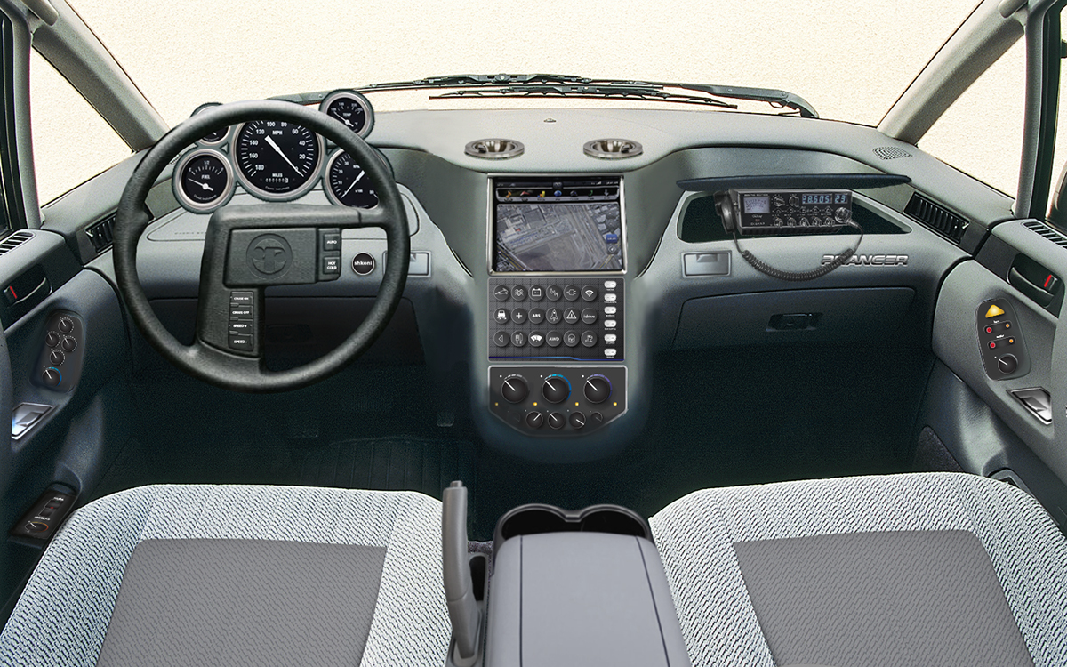


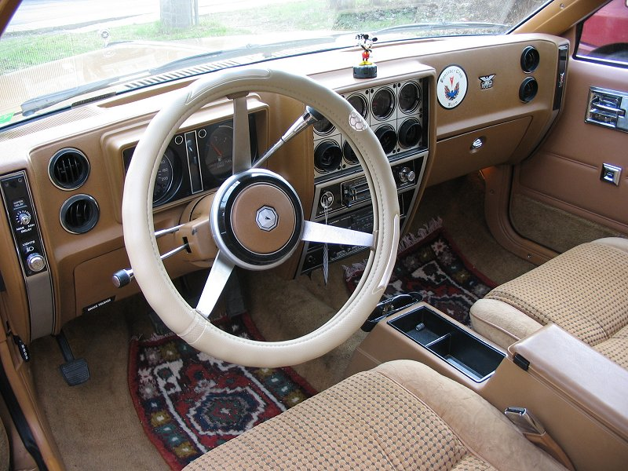




Slide 5

Architect
Senior Engineer
Junior Engineer
BREADTH of Knowledge
Stuff you know
DEPTH of Knowledge
Stuff you know you don’t know
Stuff you don’t know you don’t know

Slide 6

Core Skills
Analytical Thinking
Pragmatic thinking
Knowing how to learn
Creativity

Slide 7

The Full Stack
Fundamentals
Front-End development
Back-End development
Databases
Testing
Infrastructure
DevOps
Tooling
Patterns and Principles
User experience
Agile
Non-Functional Requirements

Slide 8
Patterns and Principles
Easy to Change
Principle
Principle
Principle
Principle
Pattern
Pattern
Impl
Impl
Impl
Impl

Slide 9

Non-Functional REQUIREMENTS
Scalability
Availability
Security
Usability
Maintainability
Reliability
Reusability
Testability
Observability

Slide 10
Fundamentals
Languages / paradigms
Scripting
Object-oriented
Functional
Reactive
Clean code
Idiomatic code
Abstraction
Modularity / reuse
Debugging

Slide 11

Soft Skills

Slide 12

Leadership
Know the why
Ask questions
Collaborate
Strong opinions weakly held
Take initiative
Lead yourself
Notes:
Talk with the business stakeholders
Ask questions to get a clear understanding of the requirements
Ask questions – THINK AHEAD – Anticipate issues
Collaborate – work as a team, work with other teams
Don’t be afraid to let people know your thoughts – speak up – but keep an open mind and be willing to admit when you’re wrong
Don’t wait for someone else to unblock you, or reach out to someone – do it! We are the they
Lead yourself – time management, meet and exceed expectations, be someone who can be counted on

Slide 13

Relationships
Don’t be a jerk
Patience
Communication
Don’t be afraid to reach out to the right person
Respect others’ time
Be empathetic
Notes:
Kindness.
Don’t use jargon to intimidate people
Don’t intimidate people
Be patient with people (when you can)
COMMUNICATION – Be able to communicate technical information to others
COMMUNICATION – LISTEN!!!
Communication – learn to overcome language barriers
Don’t worry too much about org structure – find the right person and ask the questions that need asking
BUT, respect others time (no hello, do your due diligence before reaching out)
Find common ground with people
Understand their point of view, their challenges

Slide 14

Have a Growth Mindset
Never stop learning
Ask for help & help others
Seize opportunities
Gaining and sharing knowledge
Notes:
Learn a new language (programming or not), framework, etc.
Dig in to something you don’t understand
When you don’t know something, ask for help, and help others in similar situations
EMBRACE your imposter!
OPPORTUNITIES
- Mentorship
- CODE REVIEWS
- Presentations
- Say “I don’t know” and find the right person to answer a question
- Participate in meetings
Be proficient and gaining and sharing knowledge

Slide 15

Attitude
Take pride in your work
Own your code
Contribute to your culture
No broken windows

Slide 16

Is Generative AI is going to steal your job?

Slide 17

Where AI will have an impact
Gaining proficiency in unfamiliar languages and frameworks
Reducing keystrokes
Finding answers
Applying accepted solutions to existing problems

Slide 18
The Things AI Can’t Replace
Big picture analysis and design
Idiomatic and pragmatic thinking
Knowing which problem to solve
Non-functional requirements
The soft skills

Slide 19

How to get promoted
Make an impact

